Slide 1
Type 2 Diabetes in Native Americans: Using cultural aspects for prevention and intervention programs
Kaylin Gilkey

Slide 2
What’s Coming Up
Native American 101
Traditional Native American diet
Statistics/Facts
Government programs/grants
Some current programs
Research Studies
What methods/programs work best? So what?...

Slide 3
Native American or American Indian?
American Indian or Alaska Native person is someone who has blood degree from and is recognized as such by a federally recognized tribe or village (as an enrolled tribal member) and/or the United States
Christopher Columbus landed on an island in the Caribbean he thought he was in India. So naturally he referred to the Natives he met as Indians. Unfortunately for those Natives he was not in India. However, the name Indian has since stuck.
Most don’t really care either way
Refer to person by tribe if known
1.2% Native Americans in US population *US census bureau 2012

Slide 4
Traditional Foods of Native Americans
Bears, beavers, buffalo, caribou, deer, moose, ducks, elk, rabbits, a variety of ﬁsh (salmon, smelt, bass, trout, sturgeon, etc.)
“wild plants” in their diets: arrowroot, bearberry, black birch, black mustard, buttercup, cattail, chickweed, chokecherry, dandelion, elderberry, evening primrose, great burdock, mint, ostrich fern, stinging nettle, thistle, watercress, wild rose, wintergreen
number of herbs for medicines
Diabetes was nonexistent when consuming a diverse variety of wild plants and animals that were rich in protein, moderate in carbohydrate, low in fat, and rich in antioxidants. The diet consisted mostly of large game, and wild plants used for food, medicine and teas
(15)

Slide 5
Statistics
AI/AN adults (aged 20+) have the highest age-adjusted prevalence rate of diagnosed diabetes compared to other major racial and ethnic groups in the United States (Centers for Disease Control and Prevention [CDC], 2011):
• 16.1% of American Indians and Alaska Natives;
• 12.6% of non-Hispanic blacks;
• 11.8% of Hispanics; and
• 7.1% of non-Hispanic whites.
diabetes prevalence rate of 16.1% in AI/AN adults is almost twice the rate of 8.3% for the total U.S. adult population (CDC, 2011)
Compared with the US general population, American Indians are 2.3 times more likely to be diagnosed with diabetes
Nationally, one in six Natives have diabetes, more than double that of white Americans
(11,13)

Slide 6
Statistics Continued
High levels of poverty for residents on reservations—49.6% compared to 13.1% in general population
Education levels, those graduated from high school or higher, lower than national average—64.4% Native Americans vs. 75.2% all races of U.S.
Median income in 2006 for AI/AN was $33,762 compared to median income of $48,451 for all US households.
A large segment of the Native community obtain most of their food from commodity food programs, supplemental foods programs, and Food Stamps
(9,20)

Slide 7
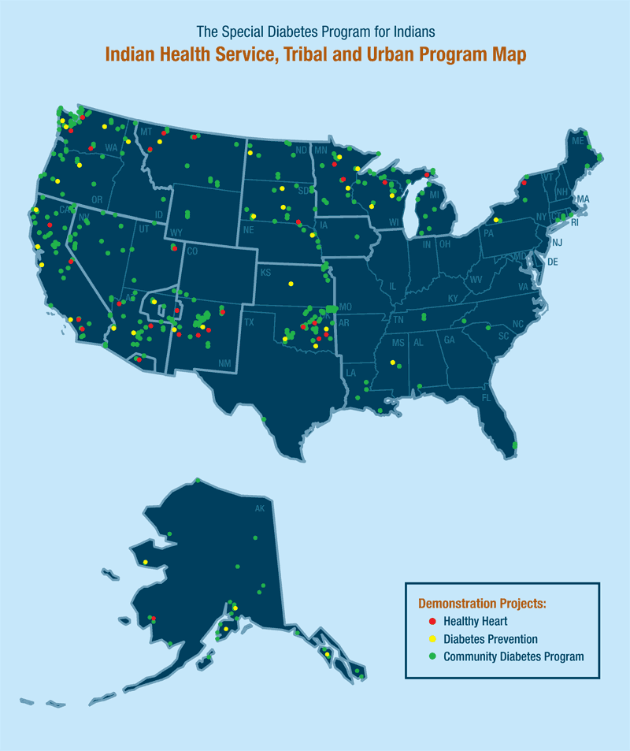
Government Programs in Place
1997—Balanced Budget Act; Special Diabetes Program for Indians (SDPI) in response to the diabetes epidemic among American Indian and Alaska Native (AI/AN) people
Indian Health Service (IHS) Special Diabetes Program for Indians (SDPI): $150 million annual program
338 SDPI Community-Directed Diabetes Programs
(13)
http://www.nihb.org/sdpi/sdpi_overview.php

Slide 8
Talking Circles
Program launched in 1996
2005--the Native Diabetes Wellness Program, in partnership with the Seva Foundation , supported Diabetes Talking Circles throughout Indian Country
Storytelling to share wisdom and inspire people to develop healthy coping skills and problem-solving abilities
Songs, chants, curing rites, prayers, lullabies, jokes, personal narratives, and stories--teach lessons from one generation to the next
been recognized by the Indian Health Services Agency as one of the most effective models for Native American communities
(19)

Slide 9
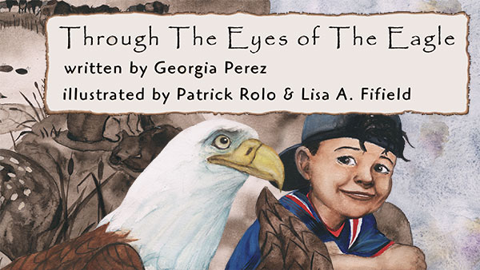
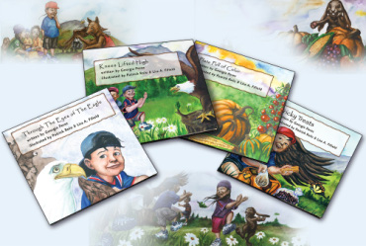
Eagle Books
“Series of four books that are brought to life by wise animal characters, Mr. Eagle and Miss Rabbit, and a clever trickster, Coyote, who engage Rain That Dances and his young friends in the joy of physical activity, eating healthy foods, and learning from their elders about traditional ways of being healthy.”
All of the stories reflect long-held traditional values of American Indian/Alaska Native people – respect, gratitude, and generosity – while teaching the universal wisdom of healthy eating and physical activity
http://www.cdc.gov/CDCTV/EyesOfTheEagle/index.html (2,4)
http://govbooktalk.gpo.gov/tag/kids-books/
http://bookstore.gpo.gov/catalog/gift-guides-calendars/gifts-books-children/eagle-book-series

Slide 10
Study 1:The Significance of a K-12 Diabetes-Based Science Education Program for Tribal Populations: Evaluating Cognitive Learning, Cultural Context, and Attitudinal Components
Table 7. Students’ Attitudes towards the Eagle Books | Area A (N=232) | Area B (N=153)
I like the Eagle Books | 92% | 92%
Eagle books were fun to read | 92% | 91%
I would like to own Eagle Books | 82% | 76%
Eagle Books make a nice gift | 88% | 88%
Diabetes Education in Tribal Schools (DETS) Health Is Life in Balance K–12 curriculum—2001—free program to schools—4 weeks
Study done to test effectiveness of DETS program
DETS curriculum focuses on three primary goals
sample size of 1,519 students, 63 teachers and 102 classes
Overall: findings described in this evaluation study show that the DETS curriculum had an effective impact relative to its three goals Teachers throughout the six content areas rated the Native American content of the DETS curriculum as strong or very strong. Across all six content areas of the three grade levels (i.e., elementary, middle, high) students consistently showed statistically significant knowledge gains
(9)
Table 8. Teachers’ Attitude towards Eagle Books | Area A (N=15) | Area B (N=10)
Liked by students | 100% | 90%
Supported lesson content | 100% | 100%
Generally relevant | 100% | 100%

Slide 11
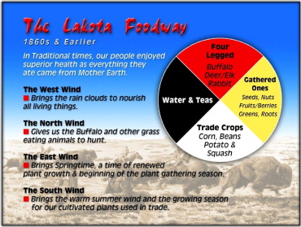
Study 2: The Medicine Wheel
One hundred fourteen Northern Plains Indians from Cheyenne River Sioux Tribe aged 18 to 65 years, with type 2 diabetes
6-month, randomized, controlled trial was conducted January 2005 through December 2005
education group received six nutrition lessons based on the Medicine Wheel Model for Nutrition. The usual care group received the usual dietary education from their personal providers
education group had a significant weight loss and decrease in BMI from baseline to completion. The usual care group had no change in weight or BMI
(14)
Figure. The Medicine Wheel, representing the four dietary components of the traditional Northern Plains Indian hunter/gatherer food pattern.

Slide 12
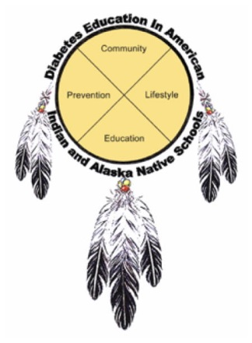
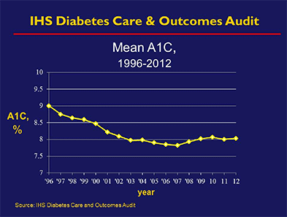
Conclusion: What Works Best
Traditional ways of eating were much healthier and physical activity was part of daily life
Tribal leaders are interested in preserving the history of their food patterns and embrace the development of educational tools depicting their historical consumption patterns
“Our cultures are the source of health” advised tribal representatives after Congress designated the Special Diabetes Program for Indians
(5,14)
http://www.ncbi.nlm.nih.gov/pmc/articles/PMC3263817/
http://www.ihs.gov/factsheets/index.cfm?module=dsp_fact_diabetes

Slide 13
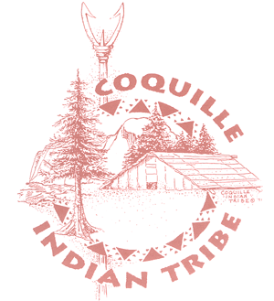
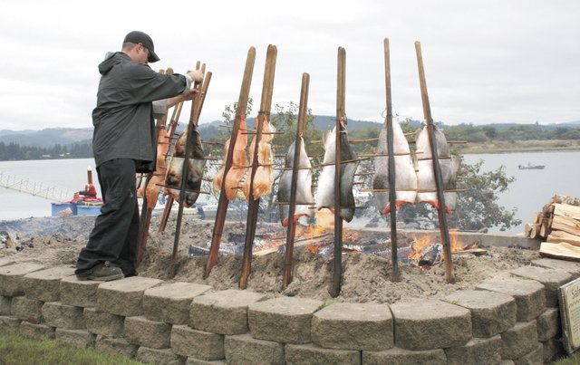
My nat. amer. Background/tribe
9 tribes in OR—7 have RD’s
Coquille Community Center:
Prevention Activities: include weight management; individual medical nutrition therapy: nutrition and exercise activities for Coquille Tribal members and spouses and non–Coquille Native Americans.
Coquille Tribe—less than 1000 members
Kelle Little, R.D./C.D.E., Health and Human Services Administrator
Salmon bake—spiritual celebration mid-September—tradition that stretches back more than 10,000 years
Coquille Cranberries—one of largest producers of organic cranberries
(6,7,17)
http://columbian.media.clients.ellingtoncms.com/img/croppedphotos/2012/09/16/Tribal_Meal.JPEG-0e0bf_t640.jpg?a6ea3ebd4438a44b86d2e9c39ecf7613005fe067

Slide 14
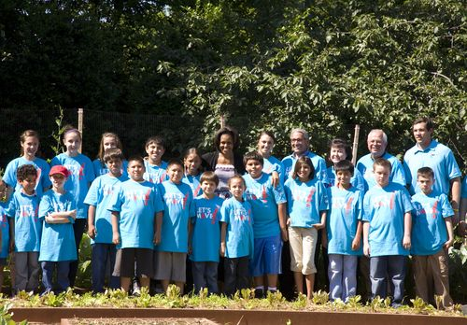
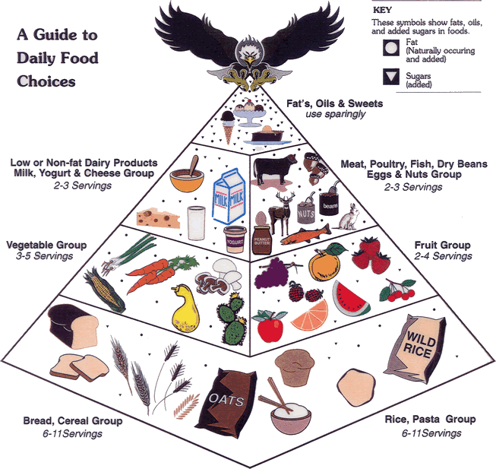
Questions?
Museum director Kevin Gover (back row, fourth from the right), First Lady Michelle Obama and a group of local Native American children at the White House's "Let's Move" harvest, June 3, 2011. (Photo by Nedra Darling - DOI)
*http://blog.nmai.si.edu/main/2011/06/how-three-sisters-a-community-garden-and-michelle-obama-.html
*http://www.nativevillage.org/Messages%20from%20the%20People/native_american_food_pyramid.htm

